Slide 1

Project Report
on
California Housing Price Prediction
Submitted by
Debatri Roy
PGP DS MAR 2021 cohort 1

Slide 2
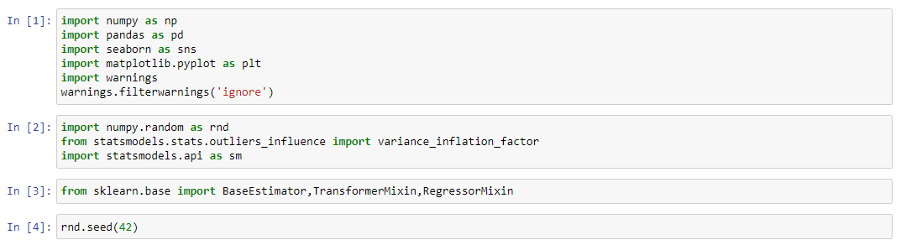
Source code in Python
Including library functions of packages
Load Dataset
(Contd.)

Slide 3
Source code in Python
Print first few rows of this data
First Portion: EDA and Data Cleaning
Getting information of Data Frame
Checking for missing values
Checking what values contains
(Contd.)

Slide 4
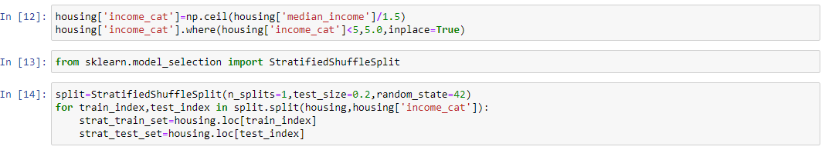
Source code in Python
Getting description of Data Frame
Histogram of housing Data Frame
Getting Test Dataset
(Contd.)

Slide 5
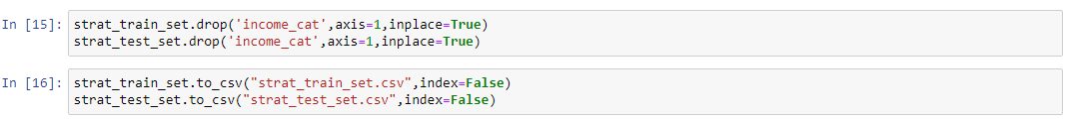
Source code in Python
Exploratory Data Analysis
(Contd.)

Slide 6
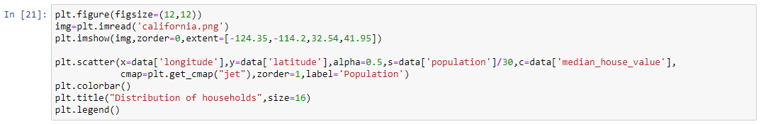
Source code in Python
(Contd.)

Slide 7
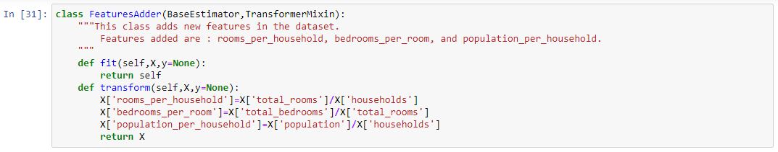
Source code in Python
(Contd.)

Slide 8
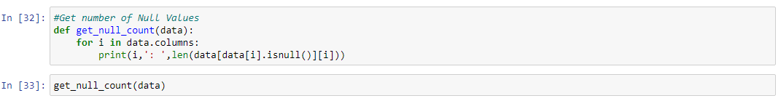
Source code in Python
Null Value Imputation
Removing Outliers
(Contd.)

Slide 9
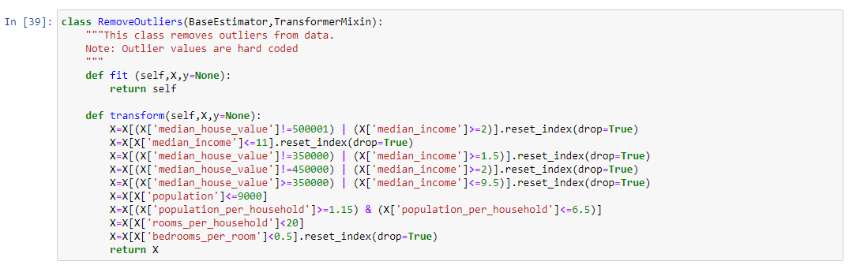
Source code in Python
(Contd.)

Slide 10
Source code in Python
Transforming skewed features
Get skewness of features
(Contd.)

Slide 11
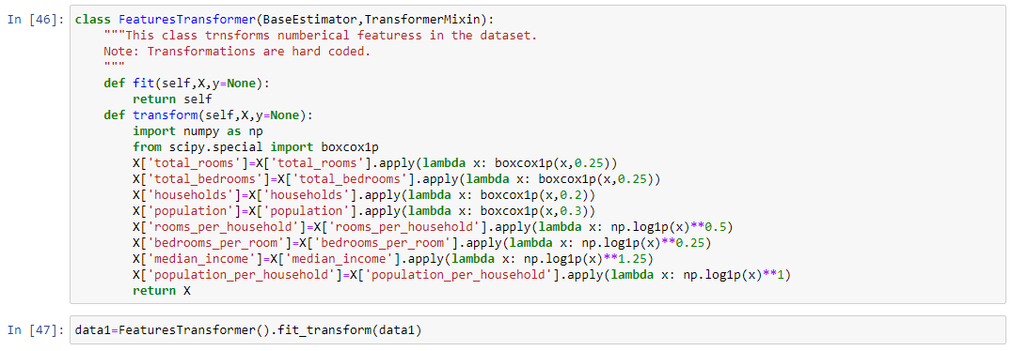
Source code in Python
Transformed features
(Contd.)

Slide 12
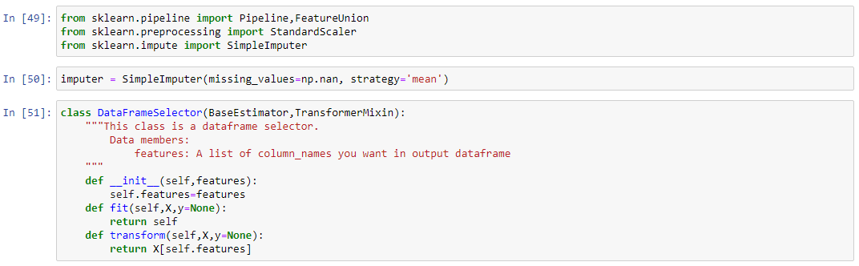
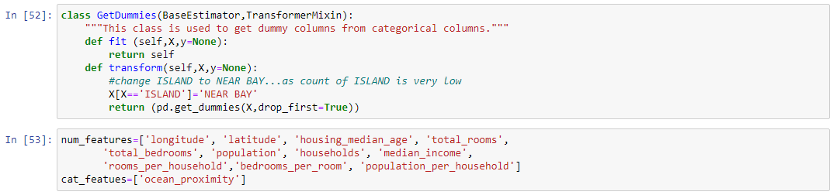
Source code in Python
Getting dummy variables and Feature Scaling
(Contd.)

Slide 13
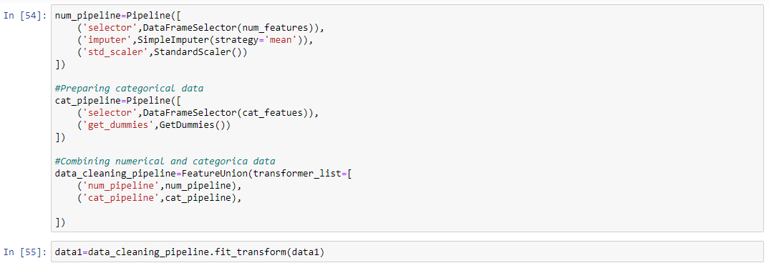
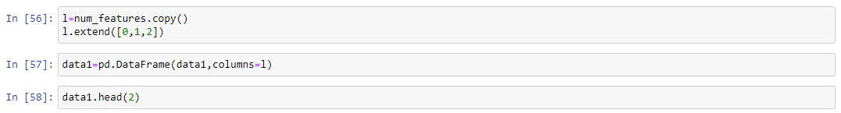
Source code in Python
(Contd.)

Slide 14
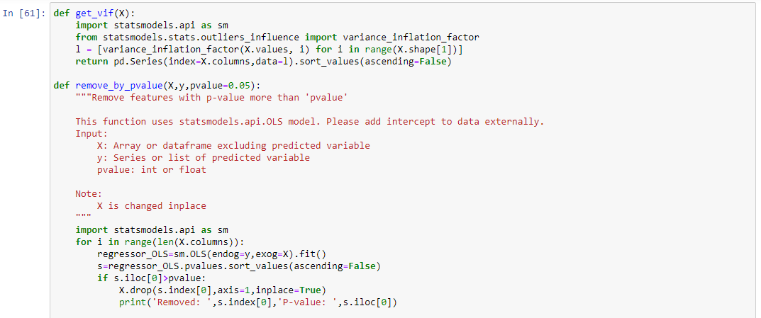
Source code in Python
Check for multicoliniearity
(Contd.)

Slide 15
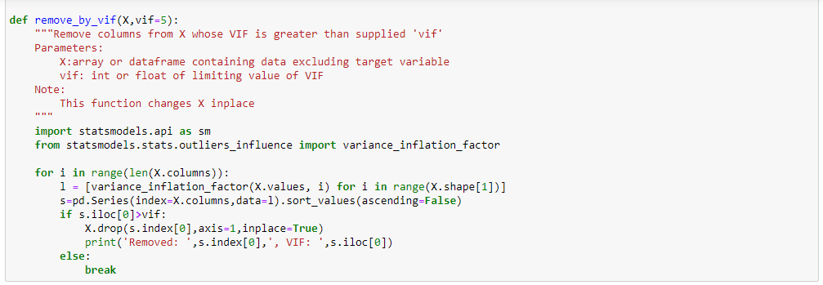
Source code in Python
(Contd.)

Slide 16
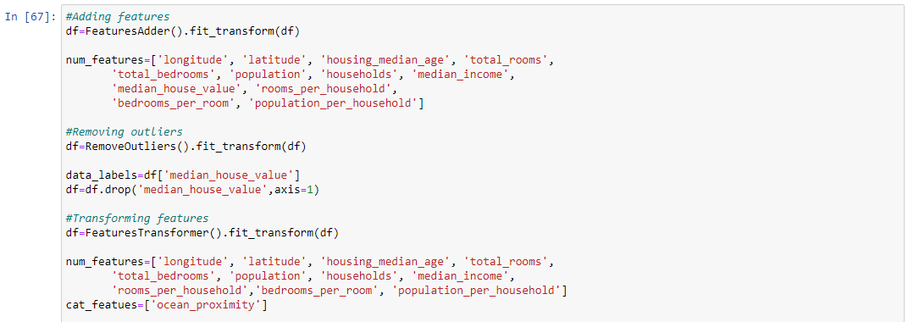
Source code in Python
Second Portion : Training machine learning algorithms
Making Train Data ready
(Contd.)

Slide 17
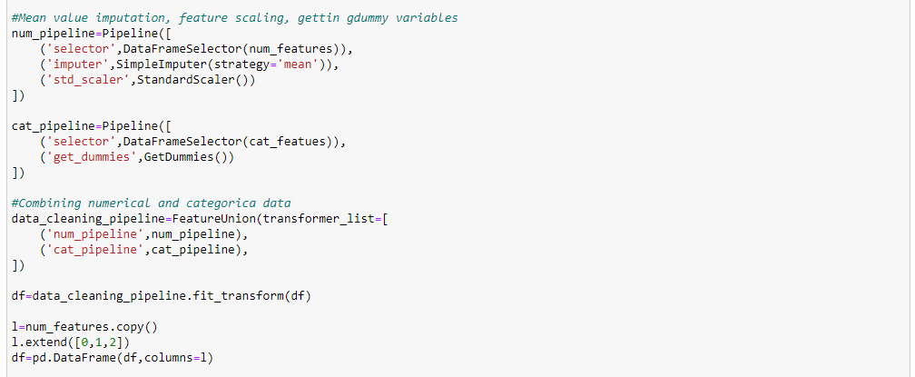
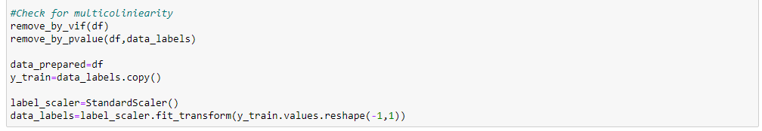
Source code in Python
(Contd.)

Slide 18
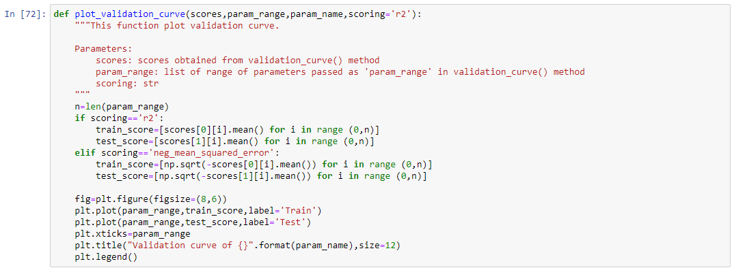
Source code in Python
Choosing ML Algorithm
(Contd.)

Slide 19
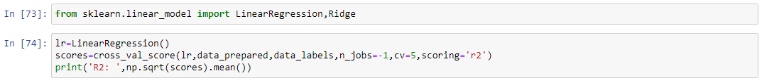
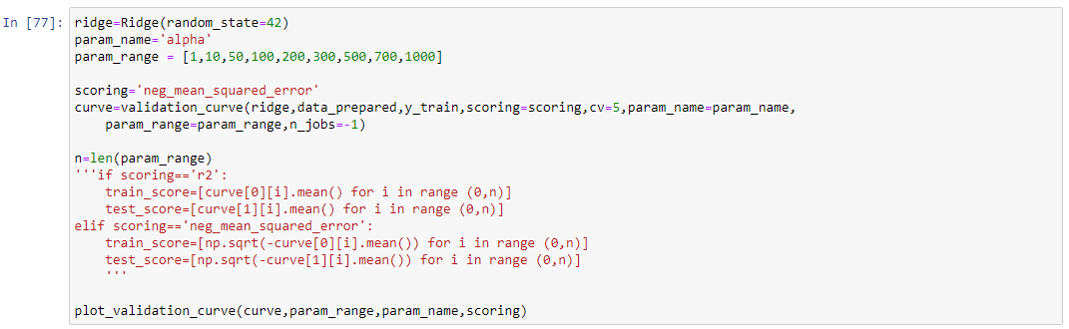
Source code in Python
Linear Regression
Ridge Regression
(Contd.)

Slide 20
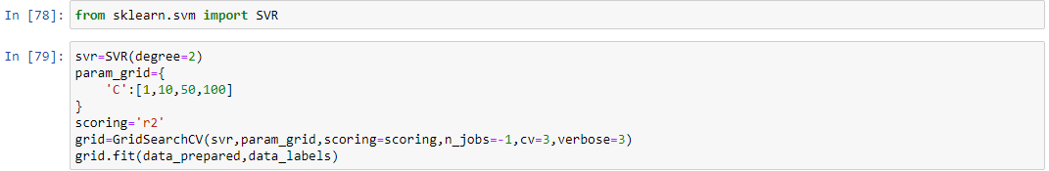
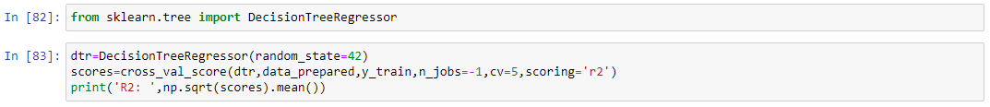
Source code in Python
Support Vector Regression
Decision Tree
(Contd.)

Slide 21
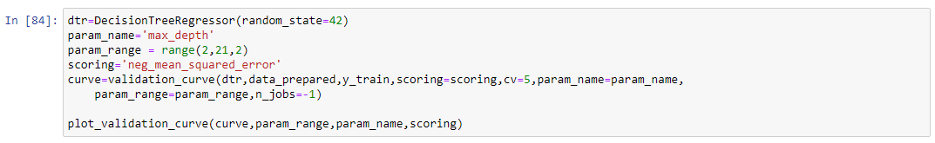
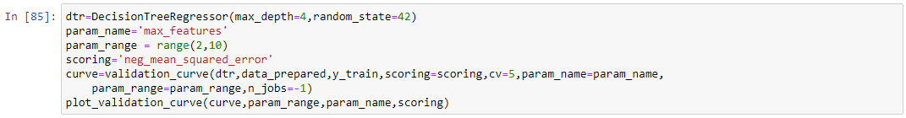
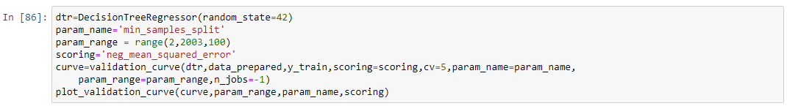
Source code in Python
(Contd.)

Slide 22
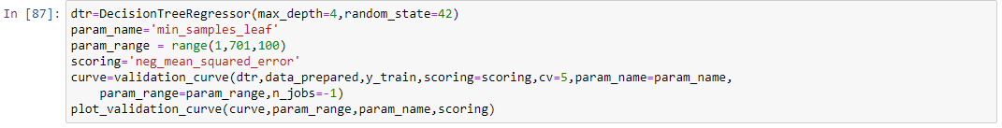
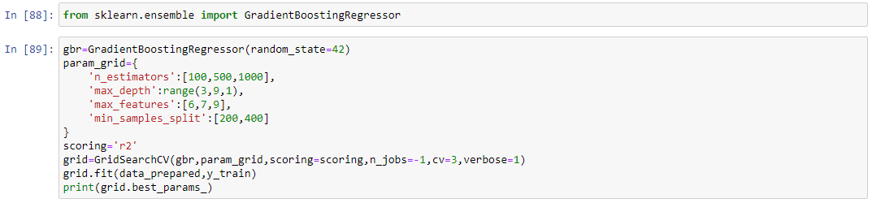
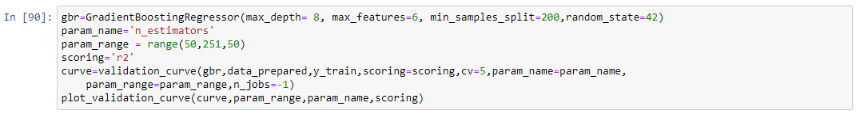
Source code in Python
Gradient Boosting Regression
(Contd.)

Slide 23
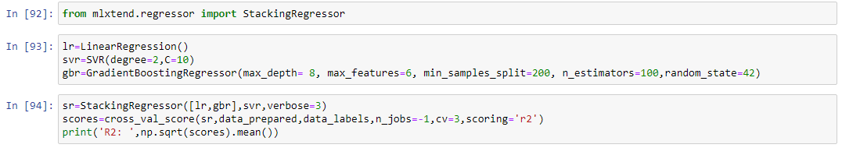
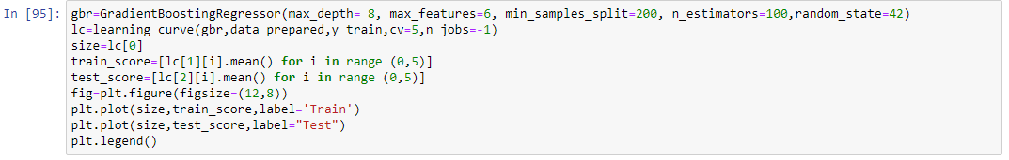
Source code in Python
Stacking
Learning Curve
(Contd.)

Slide 24
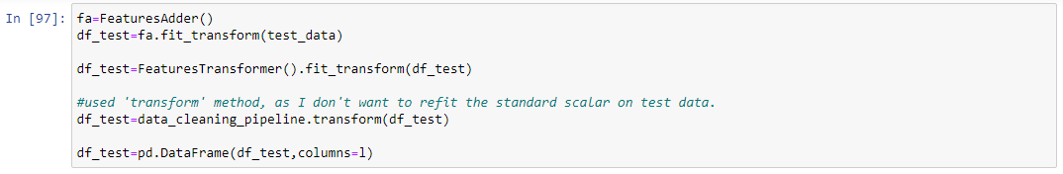
Source code in Python
Predicting on Test Data Set
Scaling test data labels
(Contd.)

Slide 25
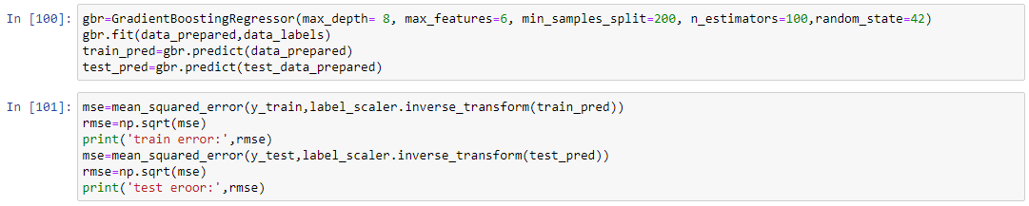
Source code in Python
Choosing same columns of test_data as of train_data

